Slide 1
Can Bus Systems
Kashif Raza
2210021
Ammar Imran Khan
2210022

Slide 2
Motivation
Need for efficient communication in automotive and industrial applications.
High wiring complexity and lack of robust error detection in previous systems.
BOSCH developed CAN Bus to address these issues.

Slide 3
Introduction
CAN acts as a communication channel for ECUs.
Enhances transmission efficiency and reduces wiring complexity.
Multi-master message broadcast system with 1 Mbps signaling rate.

Slide 4
Can Bus Standards
ISO 11898-1: Data link layer operations.
ISO 11898-2: High-speed applications, 1 Mbps, 40 meters.
ISO 11898-3: Low-speed applications, up to 125 kbit/s.

Slide 5
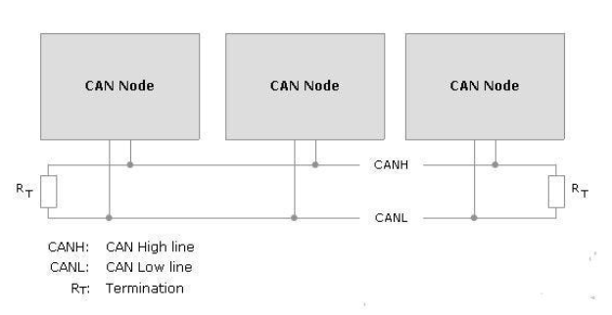
CAN NODES
Includes CAN controller, transceiver, Data bus Lines, Terminating resistors.
Nodes can be sensors, actuators, or micro-controllers.
Examples: Engine management, airbags, ABS.

Slide 6
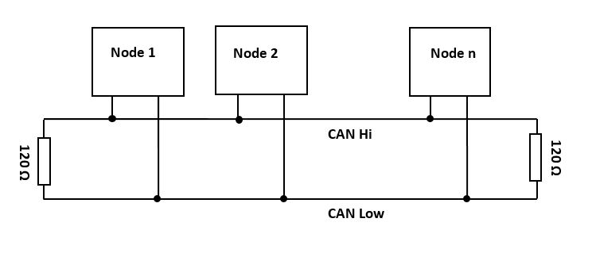
Can Network Architecture
Messages are transmitted in string of multiple bits.
Linear bus and passive star topologies.
Multiple nodes connected via CAN bus.
Twisted Copper wires, CAN High and CAN Low.

Slide 7
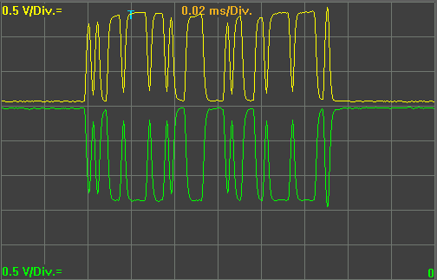
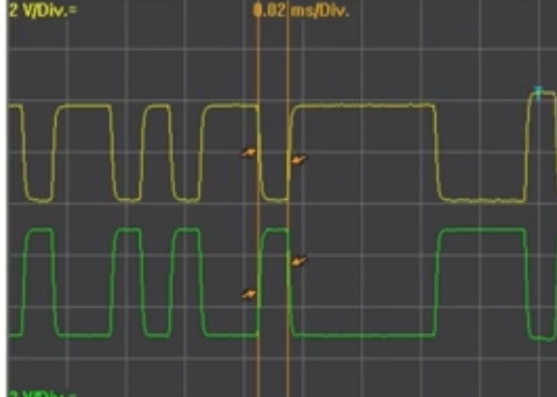
Can Network Architecture
HIGH SPEED SYSTEMS | LOW SPEED SYSTEMS
500 kbit/s | 100 kbit/s
Max 10 control units | Max 24 control units
Not single wire capable | Single wire capable
E.g. Power CAN ( Engine CU) | E.g. Connivence CAN( Interior CUs)
Base Voltage (CAN H & L=2.5V) CAN H goes up from 2.5 to 3.5 and CAN L drops from 2.5 to 1.5 | Base Voltage (CAN H=1V,CAN L=4V) CAN H drop from 4 to 1 and CAN L goes up from 1 to 4

Slide 8
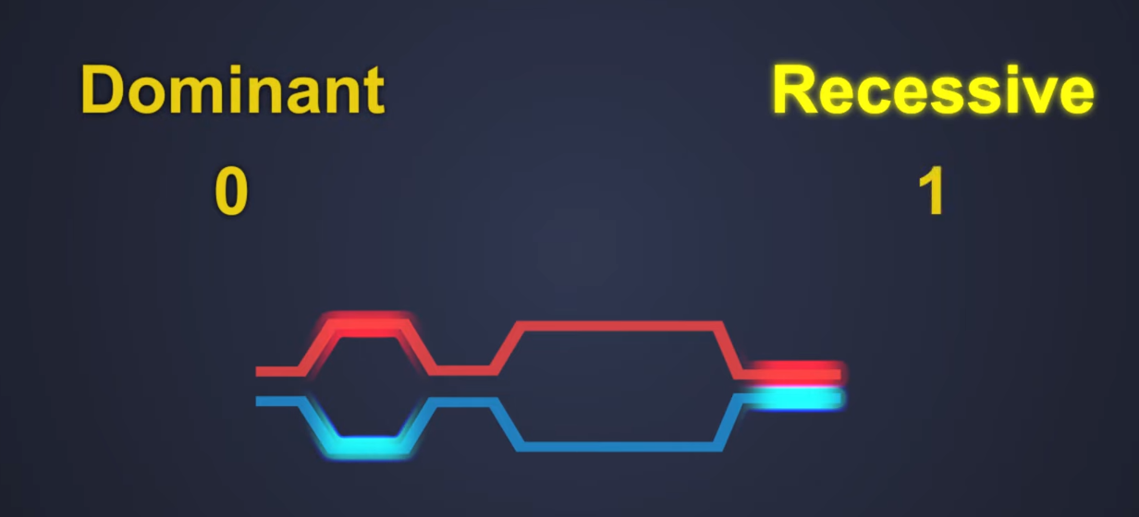
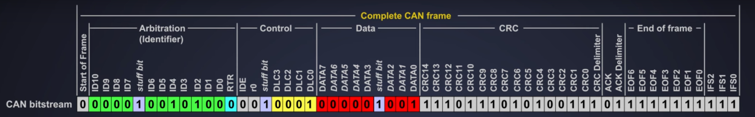
Can Frame
Standard Data Frame (CAN 2.0)

Slide 9
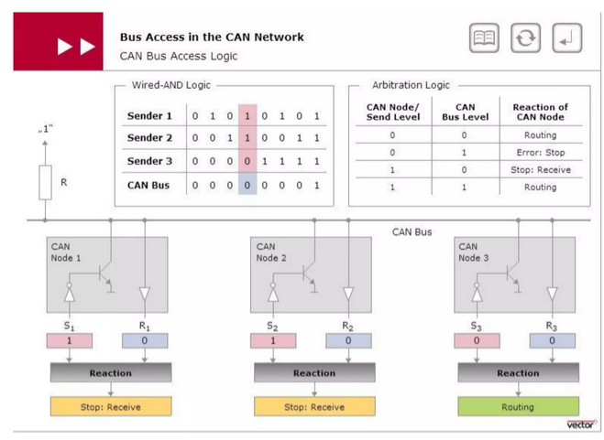
Can Bus Access
Uses CSMA/CA(Career Sense multiple access/Collision avoidance) for decentralized arbitration.

Slide 10
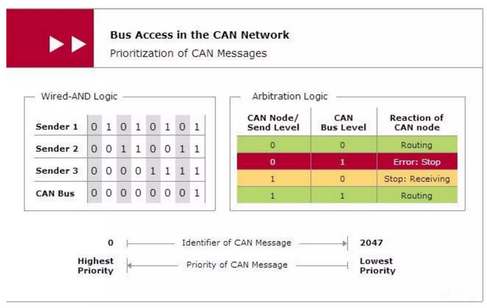
Can Bus Access
Lower numeric IDs have higher priority.
Bitwise arbitration prevents data collisions.

Slide 11
Error Detection
Ensures data integrity, confidentiality, availability.
Uses CRC for error detection, ACK for confirmation.
Physical security: EMI shielding, node access control.

Slide 12
Disadantages
Limited data rate of 1 Mbps.
Delays for lower-priority messages on busy networks.
No built-in security features.
Susceptible to physical bus faults.

Slide 13
Conclusion
Key communication standard in automotive and industrial sectors.
Reliable and efficient despite limitations.
Ongoing improvements needed for future requirements.

Slide 14

THANK YOU
FOR YOUR NICE ATTENTION

